Slide 1
Artificial Neural Networks
Prof. Dr. A K M Akhtar Hossain
Dept. Of CSE, RU

Slide 2
Artificial Neural Network (ANN)
Artificial neural network (ANN) is a machine learning approach that models human brain and consists of a number of artificial neurons.
Neuron in ANNs tend to have fewer connections than biological neurons.
Each neuron in ANN receives a number of inputs.
An activation function is applied to these inputs which results in activation level of neuron (output value of the neuron).
Before we discuss about ANN, we have to know some basic concept about biological neurons and their functions.
© Prof. Dr. A K M Akhtar Hossain Dept. of CSE, RU

Slide 3
Biological inspirations
Some numbers…
  The human brain contains about 10¹⁴ nerve cells (neurons)
  Each neuron is connected to the others through 10⁴ synapses
Properties of the brain
  It can learn, reorganize itself from experience
  It adapts to the environment
  It is robust and fault tolerant
© Prof. Dr. A K M Akhtar Hossain Dept. of CSE, RU

Slide 4
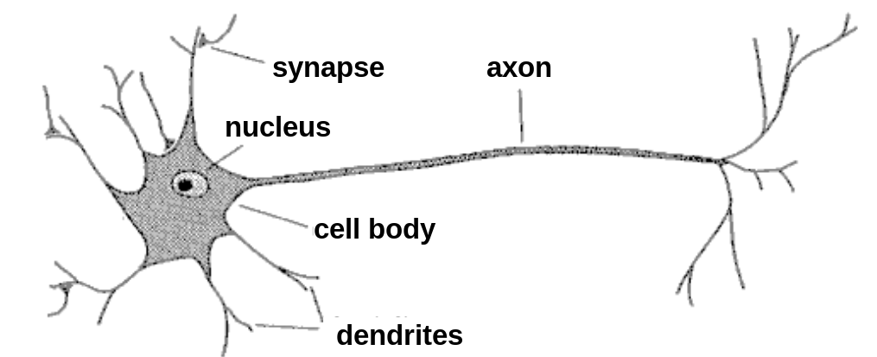
Biological Neuron
A neuron has
  A branching input (dendrites which receive input signals.)
  A branching output (the axon, which send output signals.)
The information circulates from the dendrites to the axon via the cell body.
Dendrites receive input from sensory organs such as the eyes, ears, noses, skin and from axons of other neurons.
Axons send output to organs such as muscles and to dendrites of other neurons.
© Prof. Dr. A K M Akhtar Hossain Dept. of CSE, RU

Slide 5

The McCulloch-Pitts model of the neuron
An early attempt to form an abstract mathematical model of a neuron was by McCulloch and Pitts in 1943.
Their model …..
  receives a finite number of inputs x₁ , x₂, . . . . x_{M}
  Computes the weighted sum ,
  using the weights ω₁ , ω₂ , . . . . . ω_{M}
© Prof. Dr. A K M Akhtar Hossain Dept. of CSE, RU

Slide 6
The McCulloch-Pitts model of the neuron
Thresholds s and outputs 0 or 1 depending on whether the weighted sum is less than or greater than a given threshold value T.
Node inputs with positive weights are called excitatory.
Node inputs with negative weights are called inhibitory.
© Prof. Dr. A K M Akhtar Hossain Dept. of CSE, RU

Slide 7
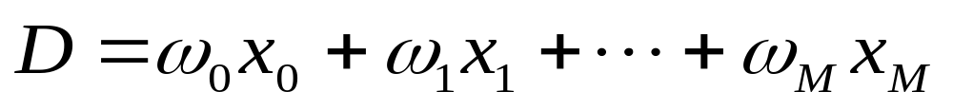
The McCulloch-Pitts model of the neuron
The action of the model neuron is output a if
(1)
and 0 otherwise.
We rewrite Eq.(1) as the sum
(2)
Where, ω₀ = -T and x₀ =1.
Output 1 if D>0 and Output 0 if D≤0.
D = Decision Parameter.
© Prof. Dr. A K M Akhtar Hossain Dept. of CSE, RU

Slide 8
The McCulloch-Pitts model of the neuron
The weight ω₀ in Eq.(1) is called the bias weight.
The input x₀ in Eq.(1) is called the bias input.
© Prof. Dr. A K M Akhtar Hossain Dept. of CSE, RU

Slide 9
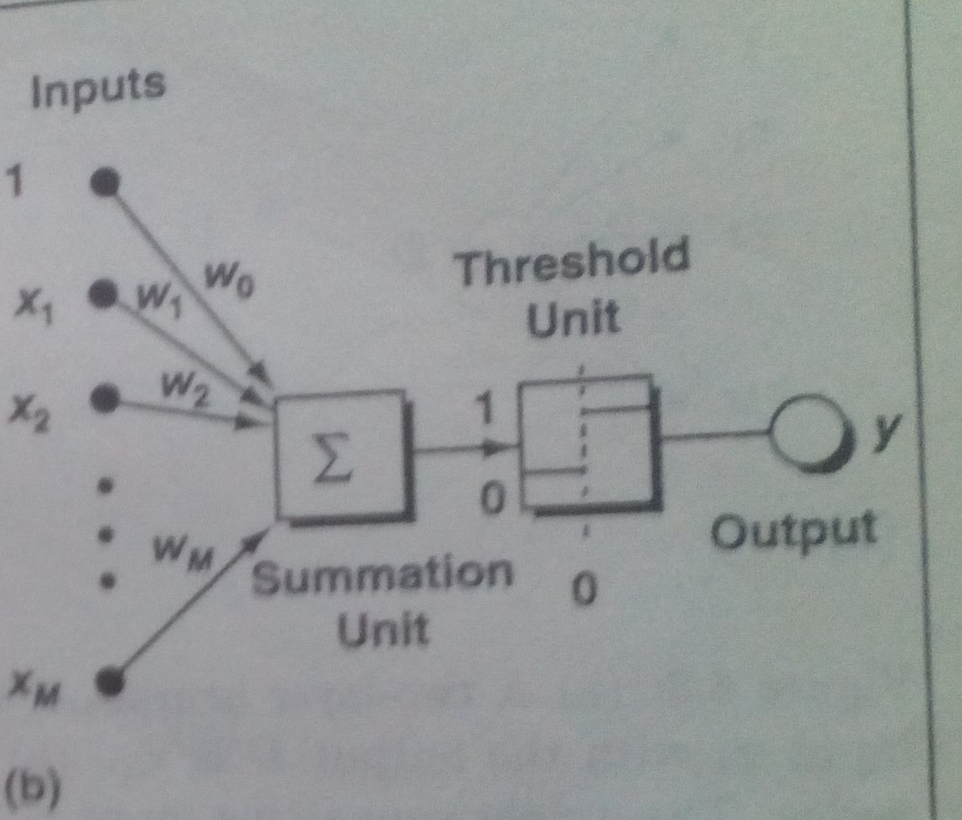
The McCulloch-Pitts model of the neuron
Model of a neuron with a bias weight.
© Prof. Dr. A K M Akhtar Hossain Dept. of CSE, RU

Slide 10
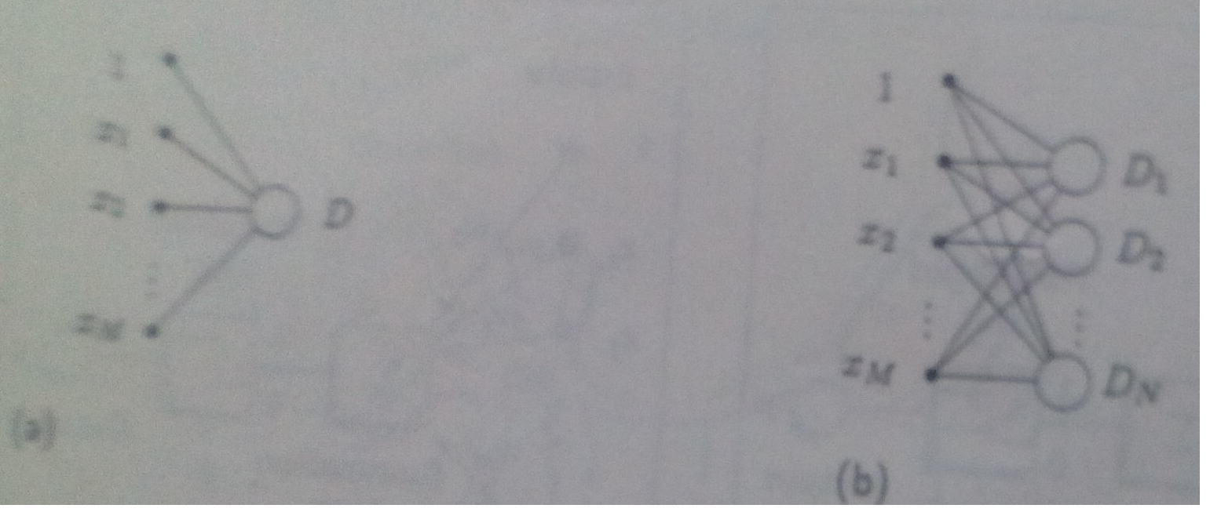
A two layer neural net
Figure(a). A two-layer neural net with one output. Fig.(b). A two-layer neural net with multiple output.
© Prof. Dr. A K M Akhtar Hossain Dept. of CSE, RU

Slide 11
Neural Networks
Artificial neural network (ANN) is a machine learning approach that models human brain and consists of a number of artificial neurons.
Neuron in ANNs tend to have fewer connections than biological neurons.
Each neuron in ANN receives a number of inputs.
An activation function is applied to these inputs which results in activation level of neuron (output value of the neuron).
Knowledge about the learning task is given in the form of examples called training examples.
© Prof. Dr. A K M Akhtar Hossain Dept. of CSE, RU

Slide 12
Contd..
An Artificial Neural Network is specified by:
  neuron model: the information processing unit of the NN,
  an architecture: a set of neurons and links connecting neurons. Each link has a weight,
  a learning algorithm: used for training the NN by modifying the weights in order to model a particular learning task correctly on the training examples.
The aim is to obtain a NN that is trained and generalizes well.
It should behaves correctly on new instances of the learning task.
© Prof. Dr. A K M Akhtar Hossain Dept. of CSE, RU

Slide 13
Applications off NNs
classification
    in marketing: consumer spending pattern classification
    In defence: radar and sonar image classification
    In agriculture & fishing: fruit and catch grading
    In medicine: ultrasound and electrocardiogram image classification, EEGs, medical diagnosis
recognition and identification
    In general computing and telecommunications: speech, vision and handwriting recognition
    In finance: signature verification and bank note verification, voice recognition, Person Identification
assessment
  In engineering: product inspection monitoring and control
  In defence: target tracking
  In security: motion detection, surveillance image analysis and fingerprint matching
forecasting and prediction
  In finance: foreign exchange rate and stock market forecasting
  In agriculture: crop yield forecasting , GIS (Geographical Information Systems)
  In marketing: sales forecasting
  In meteorology: weather prediction
© Prof. Dr. A K M Akhtar Hossain Dept. of CSE, RU
Slide <number>

Slide 14
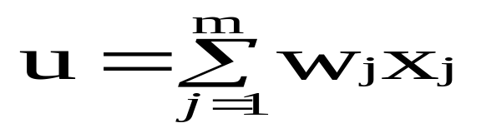

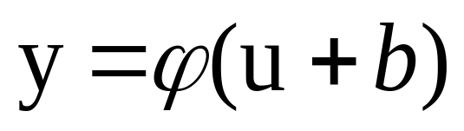
Neuron
The neuron is the basic information processing unit of a NN. It consists of:
  A set of links, describing the neuron inputs, with weights W₁, W₂, …, W_{m}
  An adder function (linear combiner) for computing the weighted sum of the inputs:
  (real numbers)
  Activation function for limiting the amplitude of the neuron output. Here ‘b’ denotes bias and the ‘u’ is the weighted sum.
© Prof. Dr. A K M Akhtar Hossain Dept. of CSE, RU

Slide 15
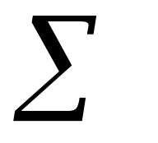
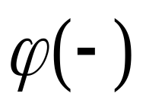

The Neuron Diagram
Bias
b
x₁
w₁
Activation
function
Induced
Field
v
Output
y
Input
values
x₂
w₂
Summing
function
x_{m}
w_{m}
weights
© Prof. Dr. A K M Akhtar Hossain Dept. of CSE, RU

Slide 16
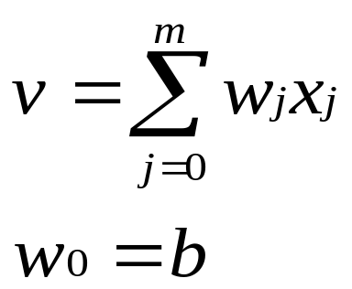
Bias of a Neuron
The bias b has the effect of applying a transformation to the weighted sum u
        v = u + b
The bias is an external parameter of the neuron. It can be modeled by adding an extra input.
v is called induced field of the neuron
© Prof. Dr. A K M Akhtar Hossain Dept. of CSE, RU

Slide 17
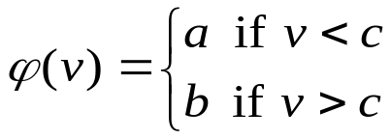

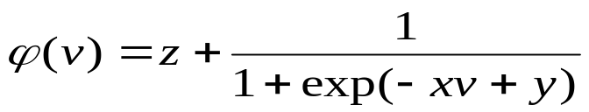
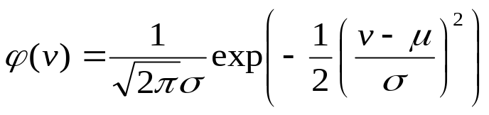
Neuron Models
The choice of activation function determines the neuron model.
Examples:
step function:
ramp function:
sigmoid function with z,x,y parameters
Gaussian function:
© Prof. Dr. A K M Akhtar Hossain Dept. of CSE, RU

Slide 18
Step Function
b
a
c
© Prof. Dr. A K M Akhtar Hossain Dept. of CSE, RU

Slide 19
Ramp Function
b
a
c d
© Prof. Dr. A K M Akhtar Hossain Dept. of CSE, RU

Slide 20
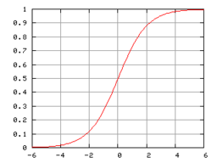
Sigmoid function
© Prof. Dr. A K M Akhtar Hossain Dept. of CSE, RU

Slide 21

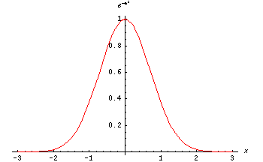
The Gaussian function is the probability function of the normal distribution. Sometimes also called the frequency curve.
© Prof. Dr. A K M Akhtar Hossain Dept. of CSE, RU

Slide 22
Network Architectures
Three different classes of network architectures
  single-layer feed-forward
  multi-layer feed-forward
  recurrent
The architecture of a neural network is linked with the learning algorithm used to train
© Prof. Dr. A K M Akhtar Hossain Dept. of CSE, RU

Slide 23
Single Layer Feed-forward
Input layer
of
source nodes
Output layer
of
neurons
© Prof. Dr. A K M Akhtar Hossain Dept. of CSE, RU

Slide 24

Perceptron: Neuron Model
(Special form of single layer feed forward)
The perceptron was first proposed by Rosenblatt (1958) is a simple neuron that is used to classify its input into one of two categories.
A perceptron uses a step function that returns +1 if weighted sum of its input ≥ 0 and -1 otherwise
b (bias)
x₁
w₁
v
y
x₂
w₂
ϕ(v)
w_{n}
x_{n}
© Prof. Dr. A K M Akhtar Hossain Dept. of CSE, RU

Slide 25
Supervised learning
The desired response of the neural network in function of particular inputs is well known.
A “Professor” may provide examples and teach the neural network how to fulfill a certain task.
In Supervised learning, you train the machine using data which is well "labeled." It means some data is already tagged with the correct answer. It can be compared to learning which takes place in the presence of a supervisor or a teacher.
© Prof. Dr. A K M Akhtar Hossain Dept. of CSE, RU

Slide 26
Supervised learning
In supervised training, both the inputs and the outputs are provided. The network then processes the inputs and compares its resulting outputs against the desired outputs. Errors are then propagated back through the system, causing the system to adjust the weights which control the network.
Example for Supervised Learning Methods:
  Artificial Neural Network
  Linear regression for regression problems.
  Random forest for classification and regression problems.
  Support vector machines for classification problems.
© Prof. Dr. A K M Akhtar Hossain Dept. of CSE, RU

Slide 27
Unsupervised learning
Unsupervised learning is a machine learning technique, where you do not need to supervise the model. Instead, you need to allow the model to work on its own to discover information. It mainly deals with the unlabeled data.
No need of a professor
  The network finds itself the correlations between the data.
© Prof. Dr. A K M Akhtar Hossain Dept. of CSE, RU

Slide 28
Unsupervised learning
In unsupervised training, the network is provided with inputs but not with desired outputs. The system itself must then decide what features it will use to group the input data. This is often referred to as self-organization or adaption.
Example for Unsupervised Learning Methods:
K-means clustering.
KNN (k-nearest neighbors)
Hierarchal clustering.
Principle Component Analysis.
Independent Component Analysis.
Apriori algorithm.
© Prof. Dr. A K M Akhtar Hossain Dept. of CSE, RU

Slide 29
Network Architectures
Different classes of network architectures:
  Multi-Layer Feed-Forward
  Backpropagation Neural Network
The architecture of a neural network is linked with the learning algorithm used to train.
© Prof. Dr. A K M Akhtar Hossain Dept. of CSE, RU

Slide 30
Multi layer feed-forward NN (FFNN)
FFNN is a more general network architecture, where there are hidden layers between input and output layers.
Hidden nodes do not directly receive inputs nor send outputs to the external environment.
FFNNs overcome the limitation of single-layer NN.
They can handle non-linearly separable learning tasks.
Input
layer
Output
layer
Hidden Layer
3-4-2 Network
© Prof. Dr. A K M Akhtar Hossain Dept. of CSE, RU

Slide 31

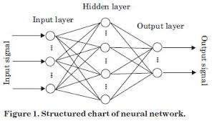
Multi layer feed-forward NN (FFNN)
© Prof. Dr. A K M Akhtar Hossain Dept. of CSE, RU

Slide 32
FFNN NEURON MODEL
The classical learning algorithm of FFNN is based on the gradient descent method.
For this reason the activation function used in FFNN are continuous functions of the weights, differentiable everywhere.
The activation function for node i may be defined as a simple form of the sigmoid function in the following manner:
where A > 0, V_{i} = ∑ W_{ij} * Y_{j} , such that W_{ij} is a weight of the link from node i to node j and Y_{j} is the output of node j.
© Prof. Dr. A K M Akhtar Hossain Dept. of CSE, RU

Slide 33
Backpropagation Neural Network : Training Algorithm:
The Backpropagation algorithm is a supervised learning method for multilayer feed-forward networks from the field of Artificial Neural Networks.
The Backpropagation algorithm learns in the same way as single perceptron.
It searches for weight values that minimize the total error of the network over the set of training examples (training set).
Backpropagation consists of the repeated application of the following two passes:
  Forward pass: In this step, the network is activated on one example and the error of (each neuron of) the output layer is computed.
  Backward pass: in this step the network error is used for updating the weights. The error is propagated backwards from the output layer through the network layer by layer. This is done by recursively computing the local gradient of each neuron.
© Prof. Dr. A K M Akhtar Hossain Dept. of CSE, RU

Slide 34
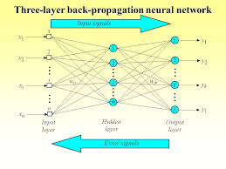
Backpropagation Neural Network :
© Prof. Dr. A K M Akhtar Hossain Dept. of CSE, RU

Slide 35
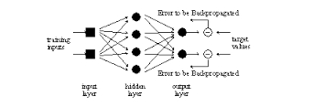
© Prof. Dr. A K M Akhtar Hossain Dept. of CSE, RU

Slide 36
Backpropagation
Back-propagation training algorithm
Backpropagation adjusts the weights of the NN in order to minimize the network total mean squared error.
Network activation
Forward Step
Error propagation
Backward Step
© Prof. Dr. A K M Akhtar Hossain Dept. of CSE, RU

Slide 37
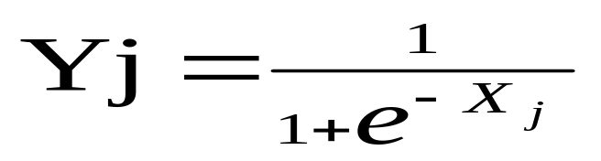
Contd..
Consider a network of three layers.
Let us use i to represent nodes in input layer, j to represent nodes in hidden layer and k represent nodes in output layer.
w_{ij} refers to weight of connection between a node in input layer and node in hidden layer.
The following equation is used to derive the output value Yj of node j
where, X_{j} = ∑ x_{i} . w_{ij} - θ_{j} , 1≤ i ≤ n; n is the number of inputs to node j, and θ_{j} is threshold for node j
© Prof. Dr. A K M Akhtar Hossain Dept. of CSE, RU

Slide 38
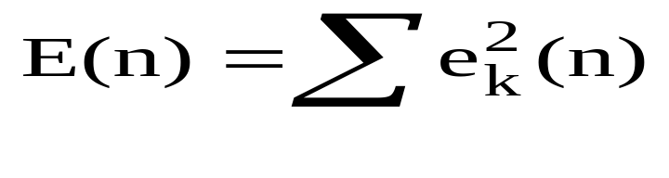
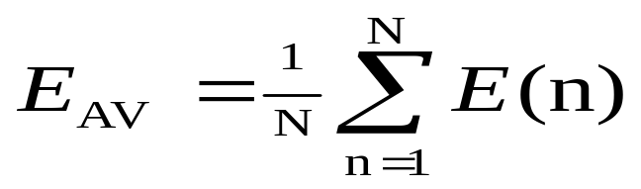
Total Mean Squared Error
The error of output neuron k after the activation of the network on the n-th training example (x(n), d(n)) is:
    e_{k}(n) = d_{k}(n) – y_{k}(n)
The network error is the sum of the squared errors of the output neurons:
The total mean squared error is the average of the network errors of the training examples.
© Prof. Dr. A K M Akhtar Hossain Dept. of CSE, RU

Slide 39
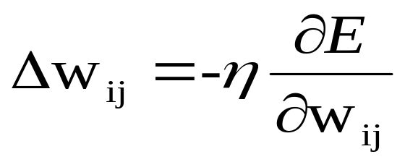
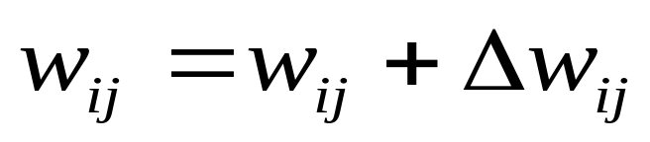
Weight Update Rule
The Back propagation weight update rule is based on the gradient descent method:
  It takes a step in the direction yielding the maximum decrease of the network error E.
  This direction is the opposite of the gradient of E.
Iteration of the Back propagation algorithm is usually terminated when the sum of squares of errors of the output values for all training data in an epoch is less than some threshold such as 0.01
© Prof. Dr. A K M Akhtar Hossain Dept. of CSE, RU

Slide 40
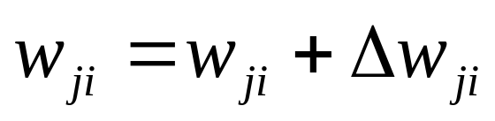
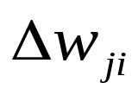
Back propagation learning algorithm
(incremental-mode)
n=1;
initialize weights randomly;
while (stopping criterion not satisfied or n <max_iterations)
  for each example (x,d)
  - run the network with input x and compute the output y
  - update the weights in backward order starting from those of the output layer:
  with computed using the (generalized) Delta rule
  end-for
n = n+1;
end-while;
© Prof. Dr. A K M Akhtar Hossain Dept. of CSE, RU

Slide 41
Stopping criterions
Total mean squared error change:
  Back-prop is considered to have converged when the absolute rate of change in the average squared error per epoch is sufficiently small (in the range [0.1, 0.01]).
Generalization based criterion:
  After each epoch, the NN is tested for generalization.
  If the generalization performance is adequate then stop.
  If this stopping criterion is used then the part of the training set used for testing the network generalization will not used for updating the weights.
© Prof. Dr. A K M Akhtar Hossain Dept. of CSE, RU

Slide 42
Backpropagation Neural Network :
This Algorithm is similar to BackPropagation algorithm [60, 62], but the major change is to calculate error rate. Here the Euclidean distance is used to calculate the error rate, which is the difference between the present output and the target output. The proposed algorithm is as follows:
The learning of MDER-BP [53] Algorithm has been accomplished by error Back Propagation Neural Network (Fig.8.7). The weight vectors and are the weighted values between layers and , and respectively.
© Prof. Dr. A K M Akhtar Hossain Dept. of CSE, RU

Slide 43


Backpropagation ….. Conti…
In the hidden layer, each PE computed the weighted sum according to the equation, which is given by
(1)
Where O_{ai} is the input of unit i for pattern number a. The threshold, uh_{j} of each PE is then added to its weighted sum to obtain the activation active_{j} of that PE i,e,
(2)
Where uh_{j} is the hidden threshold weight for jth PEs.
© Prof. Dr. A K M Akhtar Hossain Dept. of CSE, RU

Slide 44
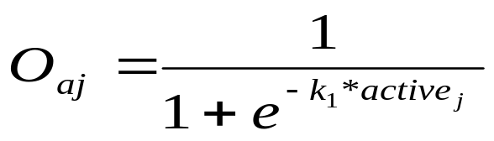
Backpropagation ….. Conti…
This activation determines whether the output of the respective PE is either 1 or 0 (fires or not) by using a sigmoid function,
(3)
Where k₁ is called the spread factors, these O_{aj} are then serve as the input to the output computation. Signal O_{aj} are then fan out to the output layer according to the relation,
© Prof. Dr. A K M Akhtar Hossain Dept. of CSE, RU

Slide 45
Backpropagation ….. Conti…
Input Patterns→
X[a][0]
X[a][1]
.
.
.
.
X[a][63]
T[a][0]
T[a][4]
W_{ij}
k₁
η₁
W_{jk}
k₂
η₂
i =Input
Layer
j = Hidden
layer
k= Output
layer
Fig.8.7 MDER- BackPropagation Neural Network
© Prof. Dr. A K M Akhtar Hossain Dept. of CSE, RU

Slide 46

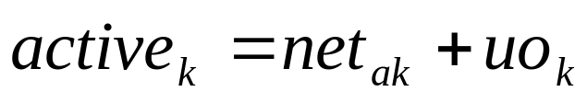
Backpropagation ….. Conti…
(4)
and the output threshold weight uo_{k} for k-th output PEs is added to it to find out the activation active_{(k)}
(5)
The actual output O_{ak} is computed using the same sigmoid function,
© Prof. Dr. A K M Akhtar Hossain Dept. of CSE, RU

Slide 47
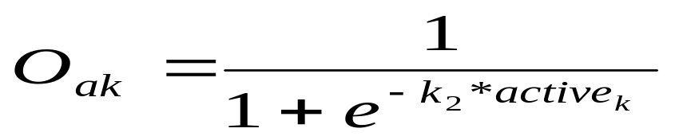
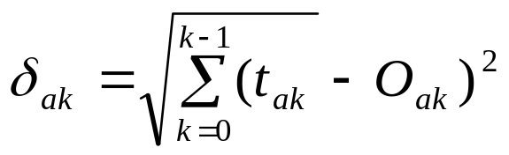
Backpropagation ….. Conti…
(6)
Here another spread factor k₂ has been employed for the output units.
In the second stage, after completing the feed‑forward propagation, an error is computed by comparing the output O_{ak} with the respective target t_{ak} ,i.e
(7)
© Prof. Dr. A K M Akhtar Hossain Dept. of CSE, RU

Slide 48
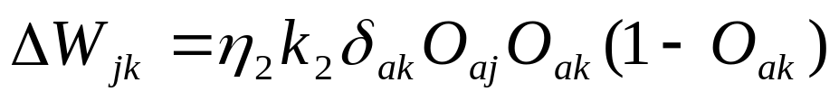
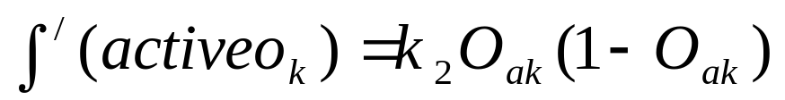
Backpropagation ….. Conti…
This error is then used to adjust the weight vector using the equation,
(8)
Where,
the derivation of sigmoid function and is the learning factor of the network.
© Prof. Dr. A K M Akhtar Hossain Dept. of CSE, RU

Slide 49


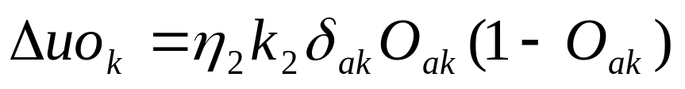
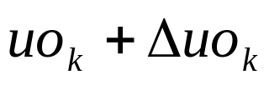
Backpropagation ….. Conti…
The weight vector is then adjusted to
. For the threshold weight of the output PE, similar equation is applied,
(9)
and the new threshold weight equaled
© Prof. Dr. A K M Akhtar Hossain Dept. of CSE, RU

Slide 50
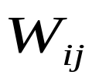

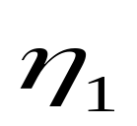

In the next step, this error and the adjusted weight vector are feedback to the hidden layer to adjust the weight vector and threshold weight uh_{j.} In this layer change in weight vector is computed by using equation,
(10)
Where, and is the learning factor of the network.
© Prof. Dr. A K M Akhtar Hossain Dept. of CSE, RU

Slide 51


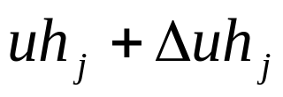
The weight vector W_{ij} is then adjusted to
.
For the threshold weights of the hidden PEs, similar equation is applied
(11)
and new threshold weights are calculated
© Prof. Dr. A K M Akhtar Hossain Dept. of CSE, RU

Slide 52
When the sum-squared error is minimum then we stop the recursion.
Finally, the weighted and threshold values are stored to test the program.
© Prof. Dr. A K M Akhtar Hossain Dept. of CSE, RU

Slide 53
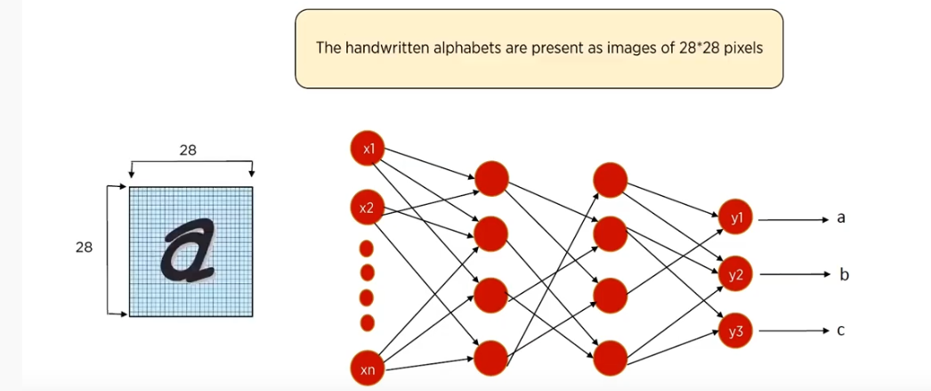
Example for Training
© Prof. Dr. A K M Akhtar Hossain Dept. of CSE, RU

Slide 54
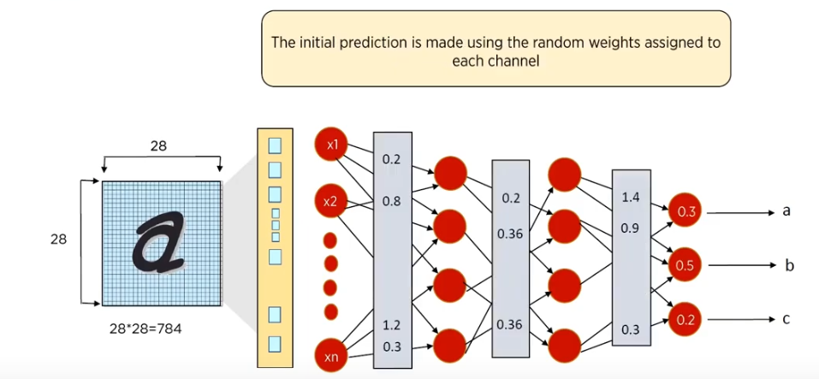
© Prof. Dr. A K M Akhtar Hossain Dept. of CSE, RU

Slide 55
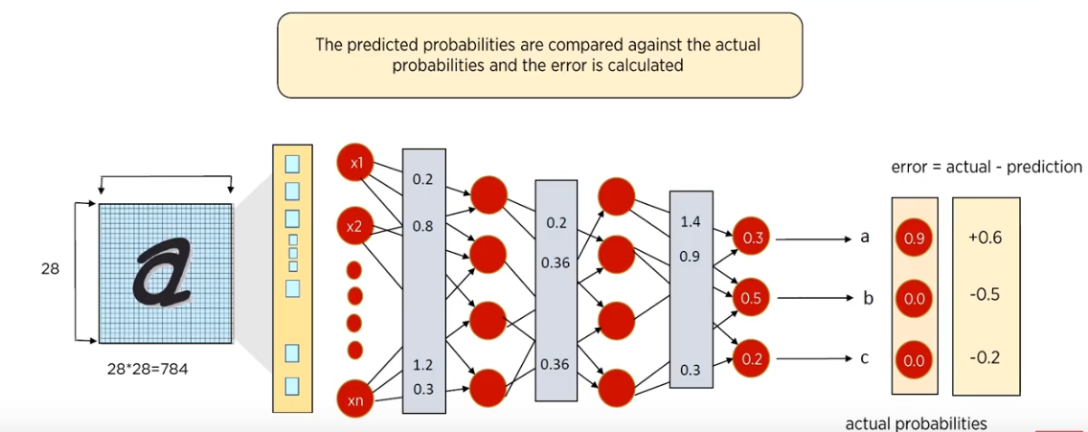
© Prof. Dr. A K M Akhtar Hossain Dept. of CSE, RU

Slide 56
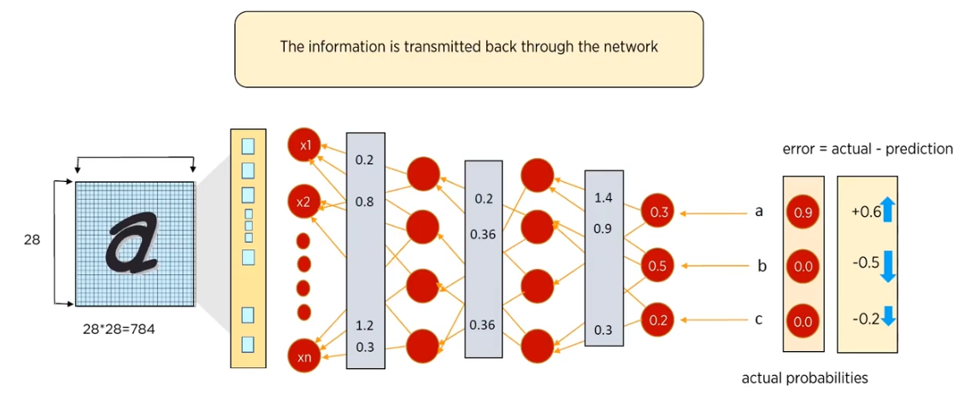
© Prof. Dr. A K M Akhtar Hossain Dept. of CSE, RU

Slide 57
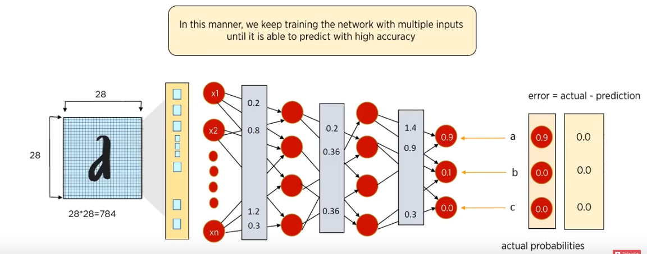
© Prof. Dr. A K M Akhtar Hossain Dept. of CSE, RU

Slide 58
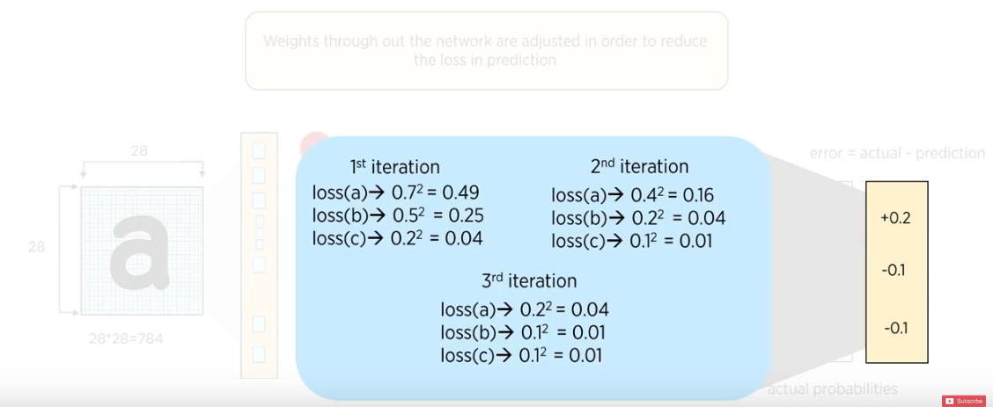
© Prof. Dr. A K M Akhtar Hossain Dept. of CSE, RU

Slide 59
THE END
© Prof. Dr. A K M Akhtar Hossain Dept. of CSE, RU

